Slide 1
Applied data science
Group Members:
Chen, Xinyi
Dubova, Elena
Hu, Xinyi
Ma, Qiaozhen
Xiao Caihui
Spring2019-Proj3-Grp5

Slide 2
CONTENT
Introduction
Models
Conclusion
Acknowledgement

Slide 3
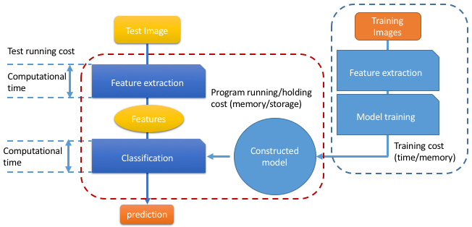
Introduction

Slide 4
Baseline Model
Prediction Algorithm
GBM
PSNR | Time
25.826 | About 2 days

Slide 5
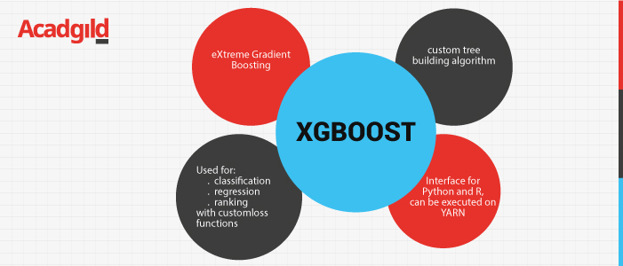
XGBOOST

Slide 6
XGBOOST Model
Prediction Algorithm
XGBOOST
PSNR | Time
25.615 | 4 hours

Slide 7
CNN Model
Keras with Tensorflow backend
GPU from Google Collab

Slide 8




CNN Train Methodology
MSE
HR whole
Divide into
HR
snippets
Downsize by 2
Generator
LR
snippets
HR
snippets

Slide 9
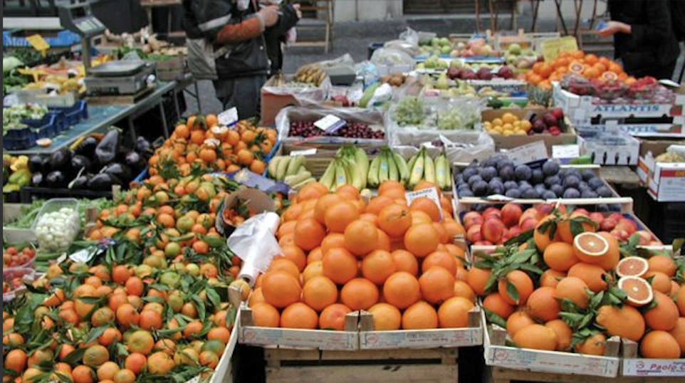
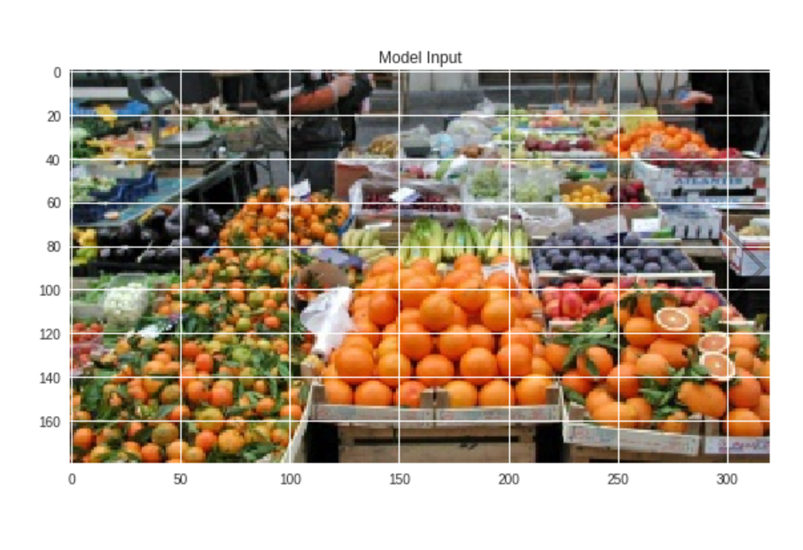


CNN Test Methodology
Ground truth
PSNR
HR
LR whole
Disperse
LR
snippets
Generator
HR
snippets
Reassemble

Slide 10
CNN Model
Prediction Algorithm
CNN
PSNR | Time
34.4 | 6 hours

Slide 11
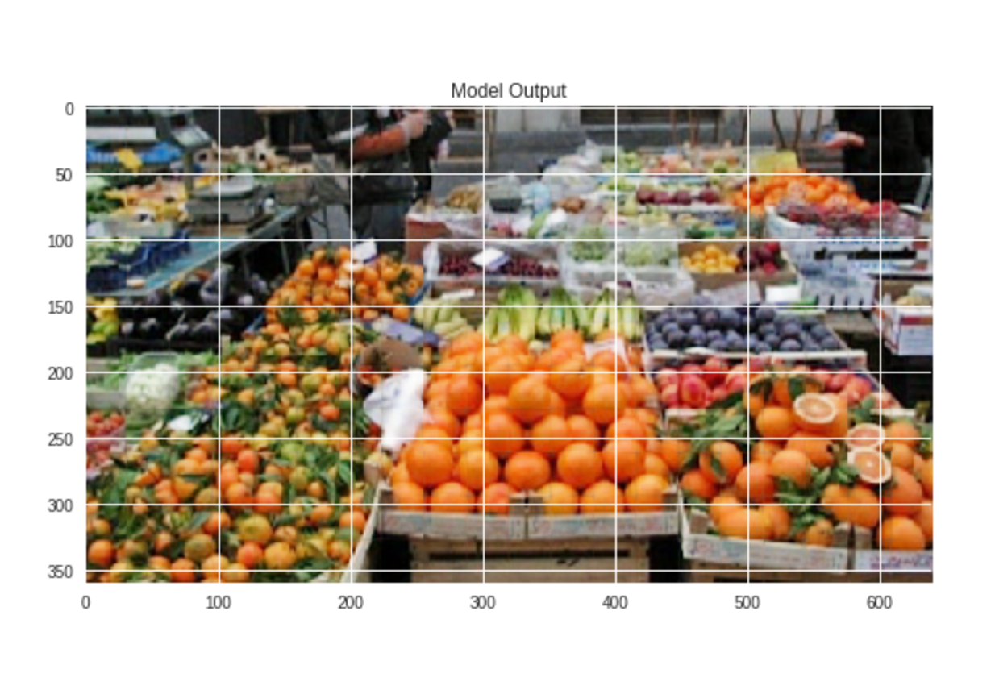
SUMMARY

Slide 12
Conclusion
We conclude that from training and cross validation results on the above analysis we choose CNN as our improved model. We take full consideration of the tradeoff between computational cost and model performance. We observe that the candidates for improved can reduce error from baseline models. Moreover, CNN algorithm can finish superResolution with much less time required from baseline model. Hence, we select CNN as our candidate for improved model.

Slide 13
WHAT NEXT?
Potential Direction 1: Include more data
Try to use LightGBM

Slide 14
Acknowledgement
We want to thank Professor Ying Liu and TA, Chengliang Tang for guiding us through the materials.

